Slide 1

Project-2 Data Wrangling
Bharti Jagyasi

Slide 2
Introduction of data wrangling and acquisition
Python libraries like pandas and numpy allow us to acquire data by fetching information from datasets.
Data wrangling also known as data munging or preprocessing is a crucial step in data analysis. It involves transforming raw data into a more usable format for better understanding, decision-making, and analysis. In Python, we often use the Pandas library for data wrangling. Let’s explore the key functionalities:
Data Exploration:
Understand the data by visualizing it in a tabular format.
Load data into a Pandas DataFrame and explore its structure.
Dealing with Missing Values:
Many datasets contain missing values (NaN). Handle them by:
Replacing NaN with mean, mode, or other relevant values.
Dropping rows with missing values.

Slide 3
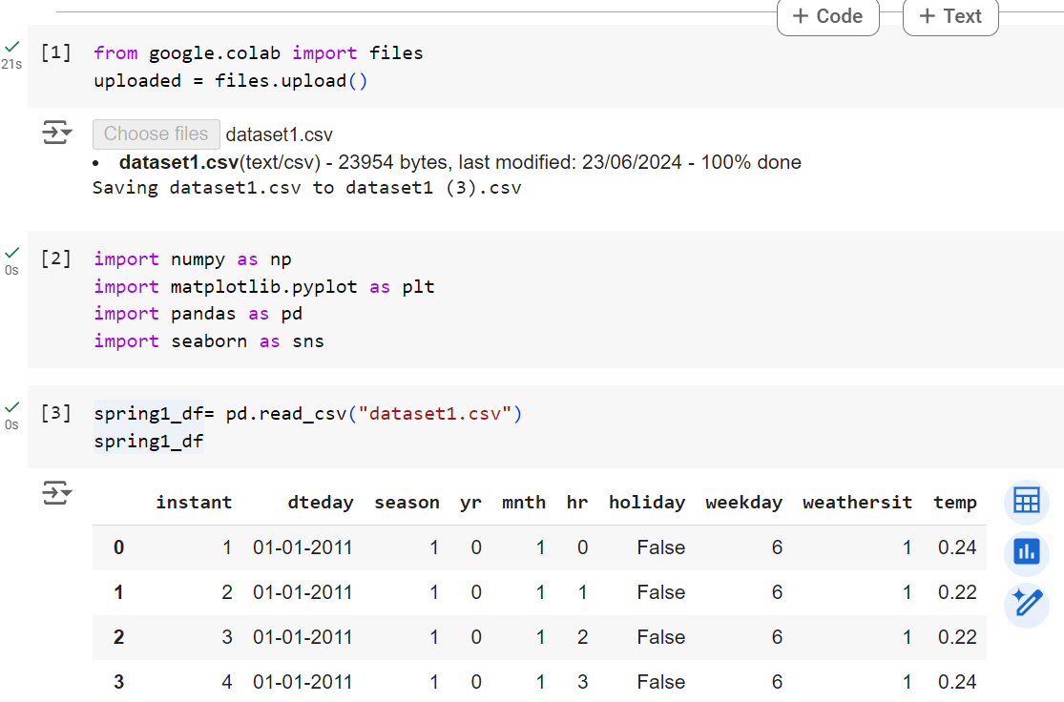
STEP 1
Firstly import the important library Pandas and numpy to read files and then start processing of dataset 1
With the help of pd.read_csv upload first dataset.
After that using .shape function to check how many rows and columns in that dataset

Slide 4
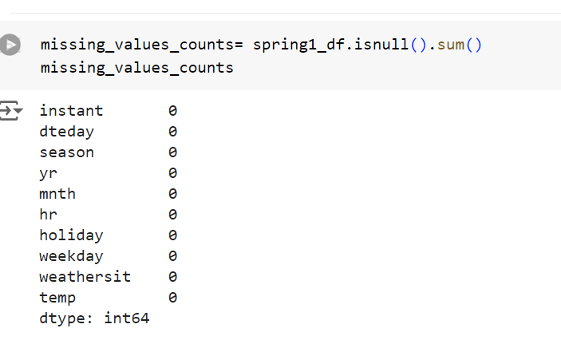
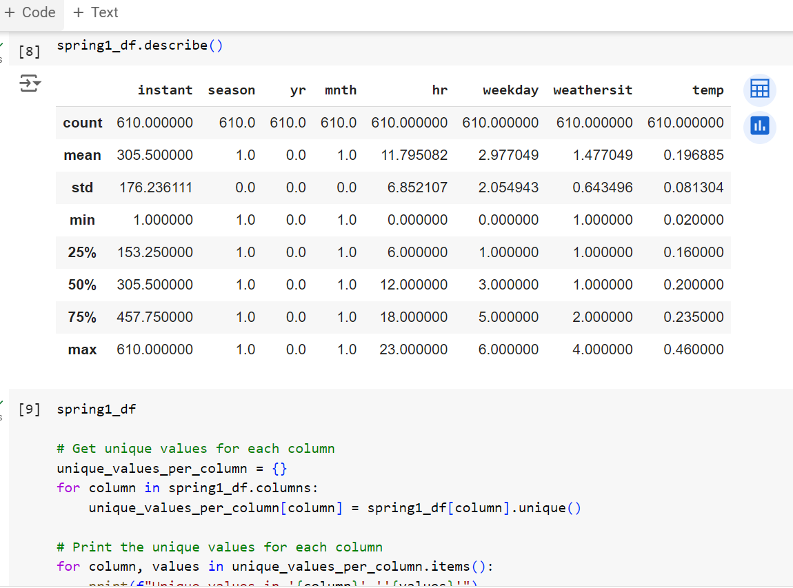
Step-2
Using .isnull().sum() function to check the null values
Then using .describe() function for count, 25% quantile and 75% quantile.
np.unique(spring1_df.instant)
Use for unique values

Slide 5
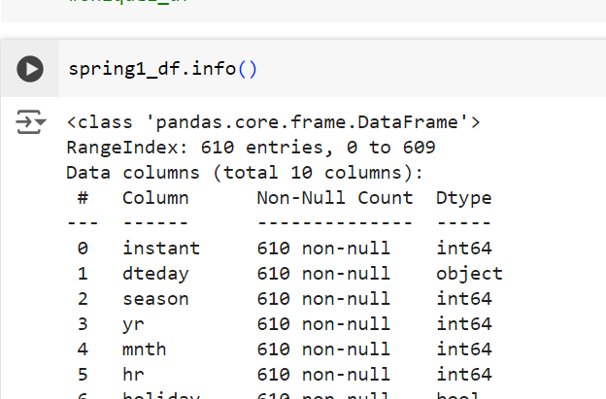
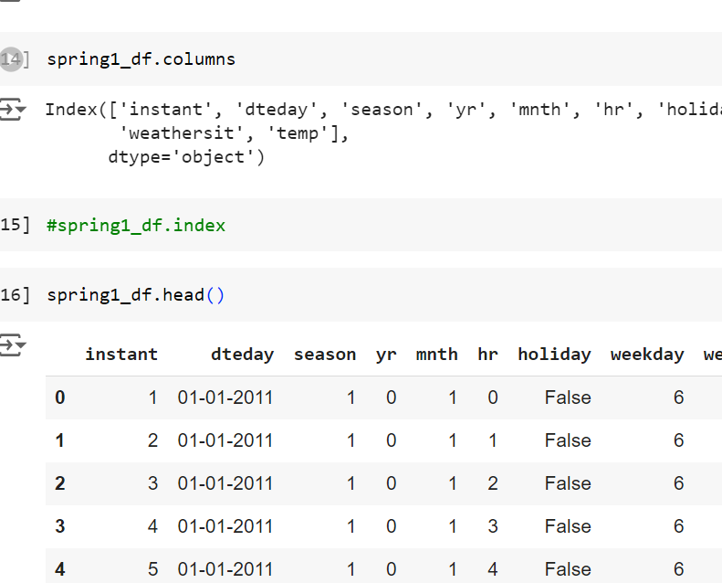
Step-3
Using .info() function to data type summary .
.columns to check all the columns which are available in dataset
.head() to check first 5 top rows and
.tail() to check last 5 rows .

Slide 6
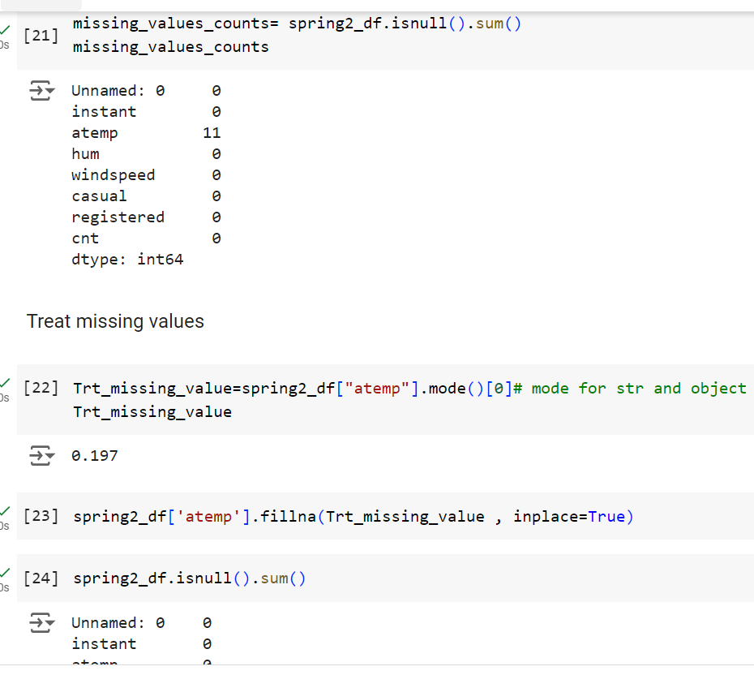
Step-4
Firtsly check the null values after that I found 11 null values then Treat null values by spring2_df["atemp"].mode()[0]
Then fill this null values .fillna(Trt_missing_value , inplace=True)

Slide 7
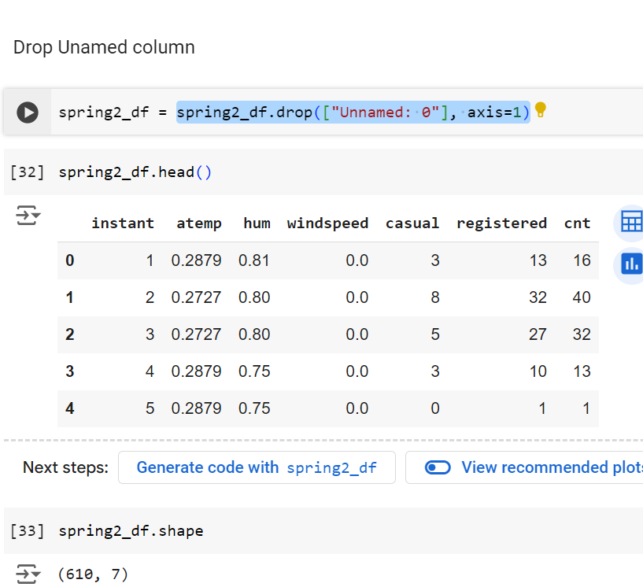
Step-5
Drop columns
Using this function I dropped this unused column name is Unnamed:0
spring2_df.drop(["Unnamed: 0"], axis=1)
Using this function we can drop rows as well.
combined_df.drop(combined_df.index[3:5], inplace=True)

Slide 8
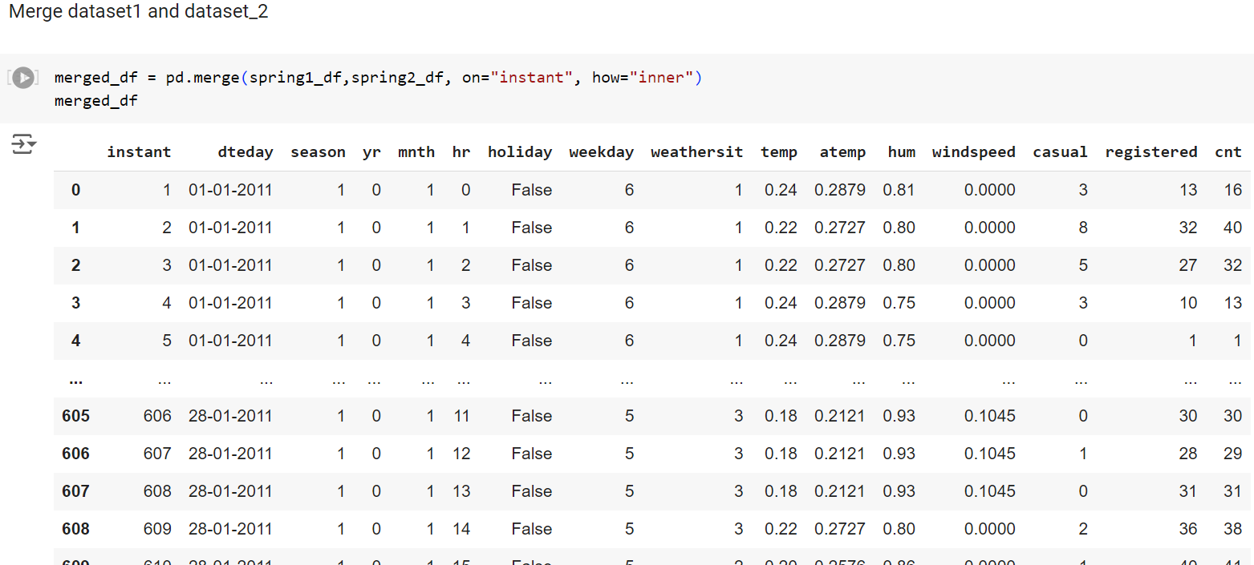
Step-6
Then next step is to merge the dataset1 and dataset_2
With the help of this function pd.merge(dataset1, dataset_2, on=“instant”, how=“inner”) both the datasets gets merged and then simply apply datatype functions , missing value count, unique values.

Slide 9
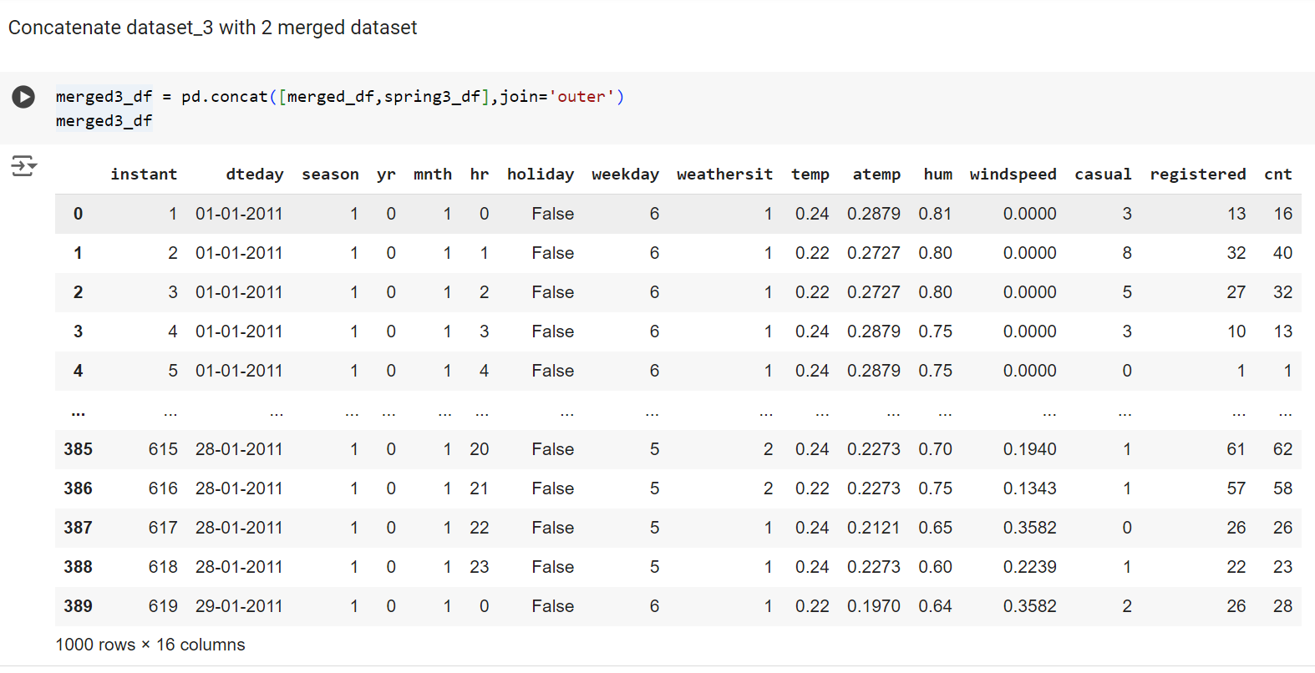
Step-7
Then next step is to upload the dataset_3 and then concatenate all the three dataset
With the help of this function pd.concat([merged_df,spring3_df],join='outer’)
All the datasets gets merged and then simply apply datatype functions , missing value count, unique values.

Slide 10
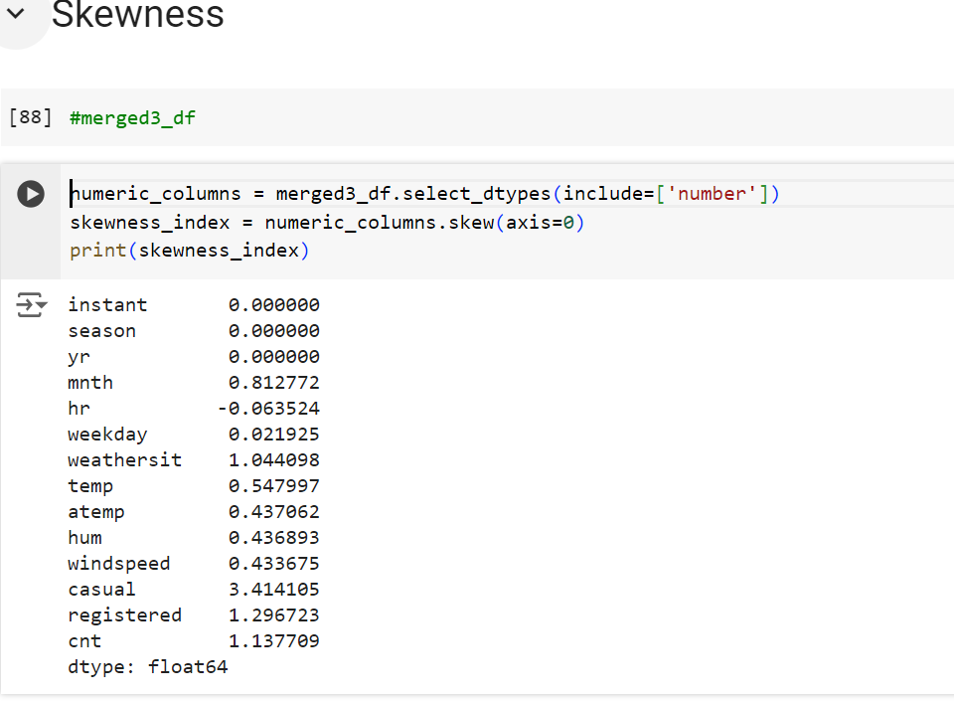
Step-8
Then next step is to find the skewness of this concatenate datasets
For that I used
numeric_columns = merged3_df.select_dtypes(include=['number'])
skewness_index = numeric_columns.skew(axis=0)
print(skewness_index)
This function can find the skewness of this datasets. This datasets contains float, int, bool and object type values so except that object values this function finds all columns skewness .

Slide 11
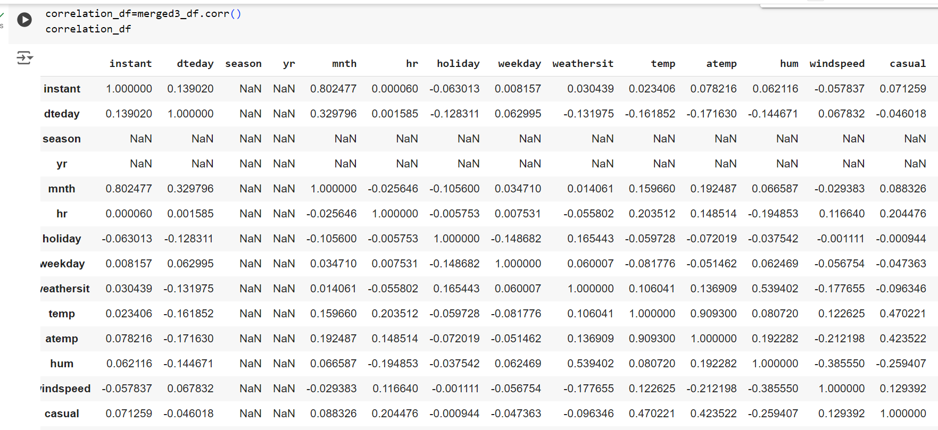
Step-9
Then last but not least step is to find the correlation of this concatenate datasets
Used this function merged3_df.corr().

Slide 12
Conclusion
Raw data often contains inconsistencies, missing values, and errors. Data wrangling helps clean and transform the data, ensuring its quality and reliability for analysis.
Python libraries like Pandas provide tools for handling missing values, removing duplicates, and correcting data inconsistencies. Python’s Pandas library simplifies data merging, joining, and concatenation.
Thank You

